Slide 1
Melissa Finucane, RAND Gulf States Policy Institute
and
K. Brent Venable, Tulane University -Computer Science
Capacity Building and Risk Communication
Tuesday October 6th, 2015

Slide 2
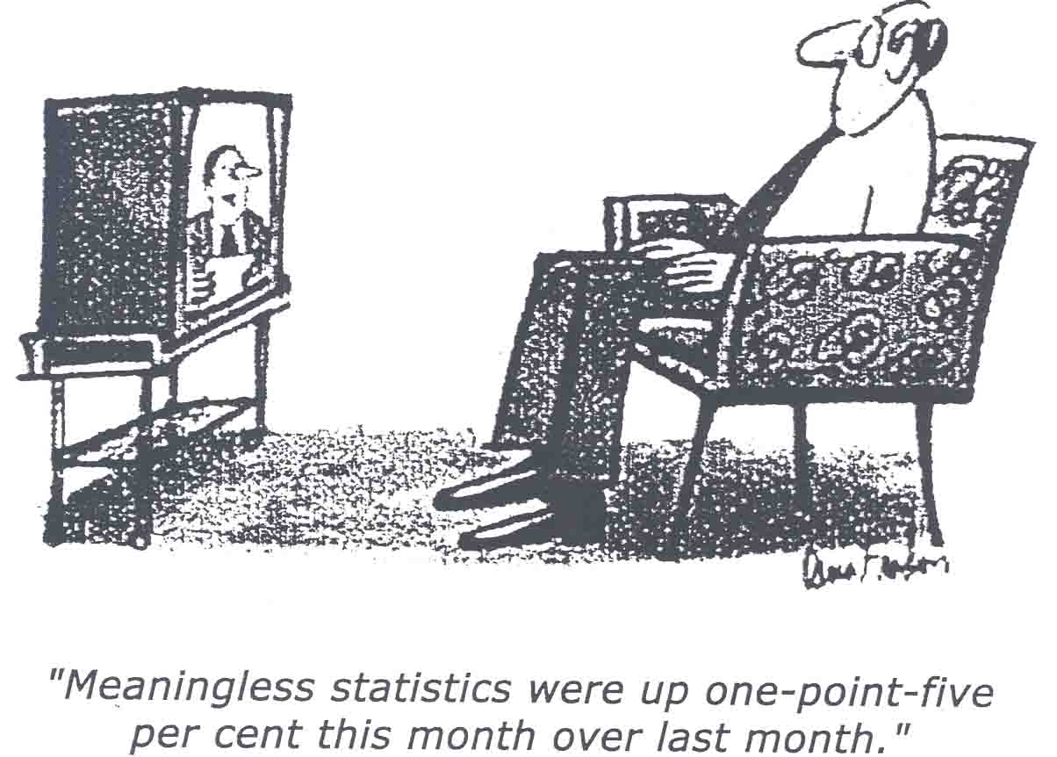
“Meaningless statistics were up one-point-five per cent this month over last month.”

Slide 3
Component Goals
Support community action planning using the data and findings established in our research
Getting the right information to the right people:
develop a web tool for ad-hoc displaying of information about the DH oil spill impacts and resilience-building strategies for different types of users (information intermediaries, county/parish emergency managers).
Produce evidence-based processes and templates for communicating about risk and resilience strategies

Slide 4
In terms of the other objectives
Objective 1 : use-inspired,
problem focused , transdisciplinary,
and iterative research,
outreach and education.
Fundamental means for effective
outreach and education
Personalized display tailors
information in terms of its use
Ease of information access promotes
transdisciplinary exchange
Objective 4: Performance evaluation
Facilitate quality and quantity measures of produced research
Provide measures for information impact assessment
Objective 3
Capacity building and
risk communication
Objective 2 : assess the medium- and long- term public health, social, and Economic impacts of the DH Oil spill
Help design strategies for communicating research findings
Provide an organized display of research products
Objective 3: train
undergraduate and
graduate students in
disaster resilience research
and outreach
2 interdisciplinary PhD
CS and Econ students
6 undergraduate CS students per year

Slide 5
Core Value
Place the decision maker and the real-world process of making a decision at the center of the research
(Moser, 2012)

Slide 6

Decades of behavioral decision has shown:
Need for predictability
Prediction impaired when faced with uncertainty
We use heuristics (rules of thumb)
Availability (recency)
Affect (feelings)
Confirmation bias (seek/retrieve/overweight info supportive of expectations)
Decisions are constructed
Decisions are context dependent
Decisions are influenced by features of the:
Decision maker
Decision Problem
Decision Context

Slide 7
Building Community Resilience to Oil Spills
Research questions about decision makers:
What capacity do decision makers have to use scientific information to support decisions about how to build community resilience?
Research questions about the decision problems:
What are the key dimensions of these decisions about how to build community resilience?
Research questions about the decision context:
Why is information used/not used in resilience decisions?

Slide 8
Decision Research Uses Mixed Methods
Behavioral decision research methods
Understanding the interaction of decision maker, decision problem, and decision context
Interviews (who wants/needs to know what and why?)
Surveys (experimental testing of info formats )

Slide 9
Artificial Intelligence Methods are used for Efficient Matching
Artificial Intelligence
Models for representing a type of user in terms of his priorities and preferences over content
Algorithms for matching priorities to content efficiently and dynamically

Slide 10

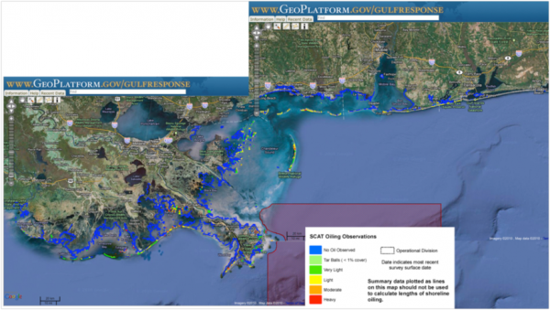

Example Fishery Industry User
Persistent shoreline
oiling & lingering
subsurface plume
Oil spill and
seafood safety

Slide 11
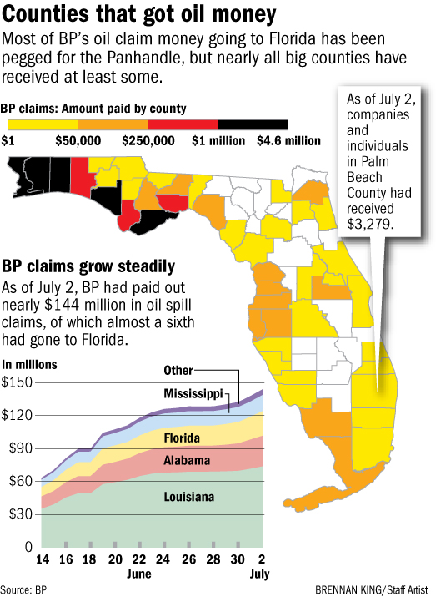
Example: Political Decision Maker
Tax revenue generated
by domestic travel in Louisiana
for federal, state, and
local governments in 2008

Slide 12
Core idea
User types
Information intermediaries
County/parish emergency
managers
Member of fishery industry
Member of tourism industry
Political decision maker…
Described in terms of content
Priorities/preferences
Information objects
Reports
Statistics
Maps
Slide decks
Describe in terms of their
content
Automated
dynamic
matching

Slide 13
Important questions
What type of users?
Which groups sharing the same content priorities are we targeting?
What type of information objects?
What kind of products will our research generate?
What type content?
What are the relevant keywords for the produced content?
Will be used to describe and match user priorities and information objects content

Slide 14
System Architecture
AI
Engine
User information
Web Interface
Registration/login/query
Personalized content
Available
Info objects
User
Content
Information objects Database
Direct query

Slide 15
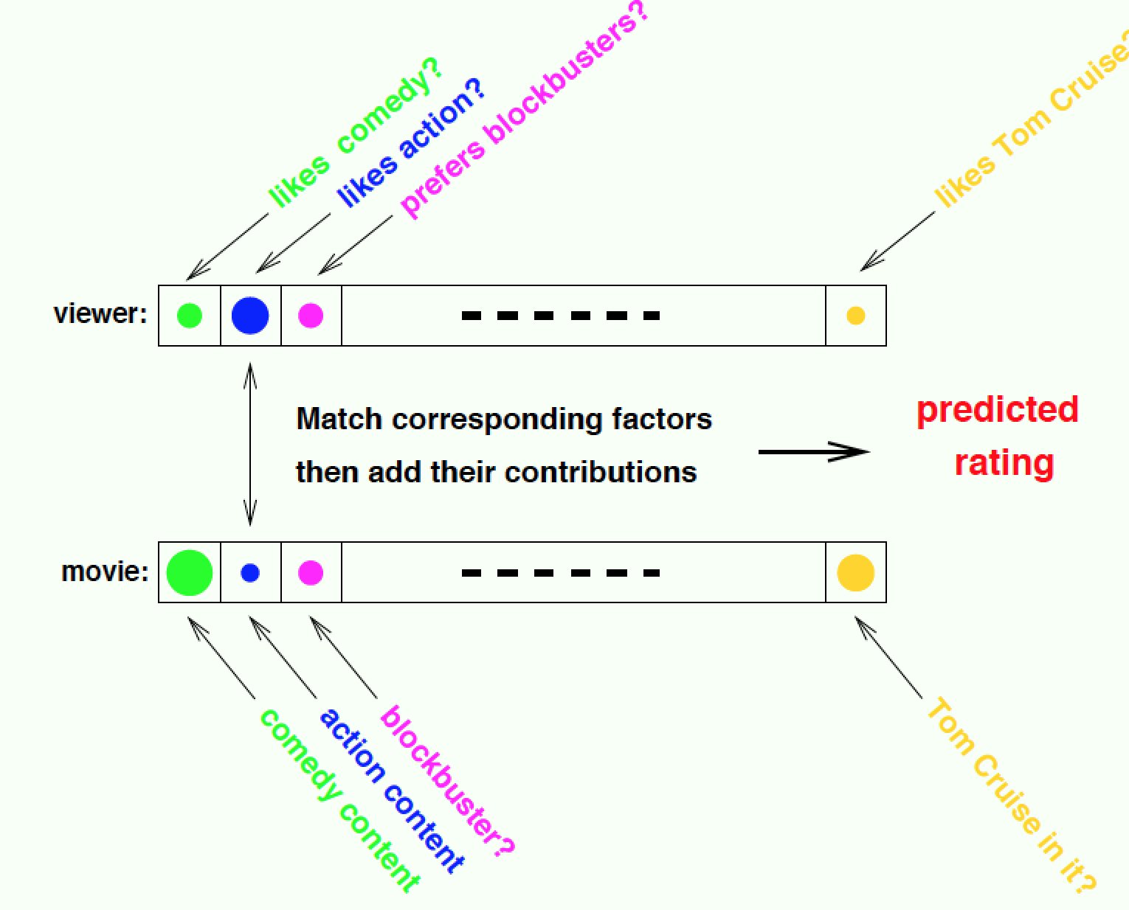
Why not an off-the-shelf recommender system?
The problem is that we don’t have the data

Slide 16
Learning how to rate movies (3)
A pattern exists. We don’t know it. We have data to learn it.
Notes:
Normalization of global effects: eliminating the baseline effects, the user specific effects and movie specific effect
Neighborhood model approaches collaborative filtering
Implicit data: if you have rated a bunch of SCiFi and no westerns you probably like SCI-Fi more than Westerns
Matrix factorization methods: users and movies into vectors of latent factors, Standard single value decomposition: predicted value is the dot product of the vectors. Asymettric SVd: user → sum of the vectors of movies she has rated.. SVD++ standard and asym combined. Temporal effects: user’s first rating, movies first rating, factors in the vectors also may change over time…
Regularization like ridge and laso regression were applied to prevent overfitting.
All combined into gradient boosted Decision Trees

Slide 17
Relational rules
Rule-based relational language for expressing preferences
Proposed by Brafman in 2008
Users and information objects described through keywords/attributes
Rules associate given user attributes to a preference level for one or more keywords
From_BayouLaBatre(u)→d.tourism (2)
From_BayouLaBatre(u)→d.shipbuilding (8)
Fisherman(u) → d.albacore (8)
Political_Decision_Maker(u) and u.location=d.location→d.tax(9)
preference

Slide 18
AI algorithms’ task
Given a user, and a set of relational rules:
Compute the top k “most relevant” information objects to be displayed on the website when the user logs in

Slide 19
Brute force approach
Given a user type (=set of attributes):
Fire the rules on all information objects
Produce a full ranking of all documents
Take the top k
k = number of objects to be shown in front page
Can be fixed
Change depending on the space occupied by the objects on the screen
Can be defined in terms of preference threshold
Object Preference
o1 100
o2 100
o3 80
o4 70
o5 65
.. …
… …
… …
o150 0
k=5
User

Slide 20
Stochastic local search
Start with a random set of k objects
Rank it with the rules
Consider all other sets obtained by replacing one document with another not yet included
Evaluate these other sets with the rules and keep the best
Continue for a given number of steps
(o1, o6, o3, o4, o5)
(o1, o2, o3, o9, o5)
(o1, o2, o3, o4, o5)
(o6, o2, o3, o4, o5)
(o1, o2, o3, o4, o100)
(o1, o2, o3, o4, o5)

Slide 21
Comparison results
Will add graph with time on the y axis and number of documents on the x-axis, and the two curves corresponding to the two algorithms

Slide 22
Hybrid users
Define a set of basic user types
Fisherman, political decision maker, etc.
Keep top k stored and updated for all the basic types
Re-run algorithms every time a new information object is added
Allow a user to belong to more than one type with different degrees od membership
Obtain top k for hybrid user by merging tops k of each relevant type

Slide 23
Year 1
Timeline
Y1Q1 – recruit staff and students; stakeholder mapping; develop & launch public website
Y1Q2 – develop methods protocols; IRB submission
Y1Q3 – decision maker assessment (conduct interviews, surveys, workshops); identify type of info objects; model priorities; design behavioral decision experiments
Y1Q4 – synthesize findings from DM assessment; initial behavioral decision experiments; model content; match user profiles with content
Products
Temporary public website developed and launched
Report/paper submission on decision maker assessment
Initial results from behavioral decision experiments
AI website design and initial testing

